Slide 1
CMSC204
Kartchner
V(StateGraph) = {Oregon, Alaska, Texas, Hawaii, Vermont, NewYork, California}
E(StateGraph) = {(Alaska, Oregon), (Hawaii, Alaska), (Hawaii, Texas), (Texas, Hawaii), (Hawaii, California), (Hawaii, New York), (Texas, Vermont), (Vermont, California), (Vermont, Alaska)}
1. Draw the StateGraph
Oregon
Alaska
Vermont
Texas
New York
California
Hawaii

Slide 2
a. Show the adjacency matrix that would describe the edges in the graph. Store the vertices in alphabetical order
States
Alaska
0 | 0 | 0 | 0 | 1 | 0 | 0
0 | 0 | 0 | 0 | 0 | 0 | 0
1 | 1 | 0 | 1 | 0 | 1 | 0
0 | 0 | 0 | 0 | 0 | 0 | 0
0 | 0 | 0 | 0 | 0 | 0 | 0
0 | 0 | 1 | 0 | 0 | 0 | 1
1 | 1 | 0 | 0 | 0 | 0 | 0
California
Hawaii
New York
Oregon
Texas
Vermont
3. b. Show the adjacency lists
that would describe the edges in the graph
Alaska
Oregon | /
California
/
Hawaii
Alaska | /
California | /
New York | /
Texas | /
New York
/
Oregon
/
Texas
Hawaii | /
Vermont | /
Vermont
New York | /
Texas | /

Slide 3
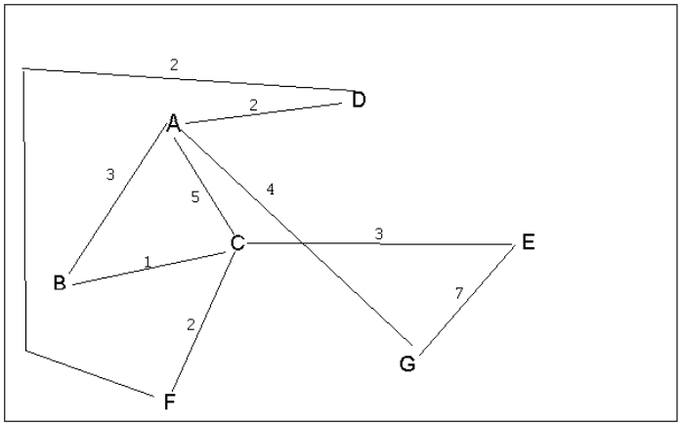
4 a. Which of the following lists the graph nodes in depth first order beginning with E?
C) E, G, A, D, F, C, B
4 b. Which of the following lists the graph nodes in breadth first order beginning at F?
A) F, C, D, A, B, E, G

Slide 4
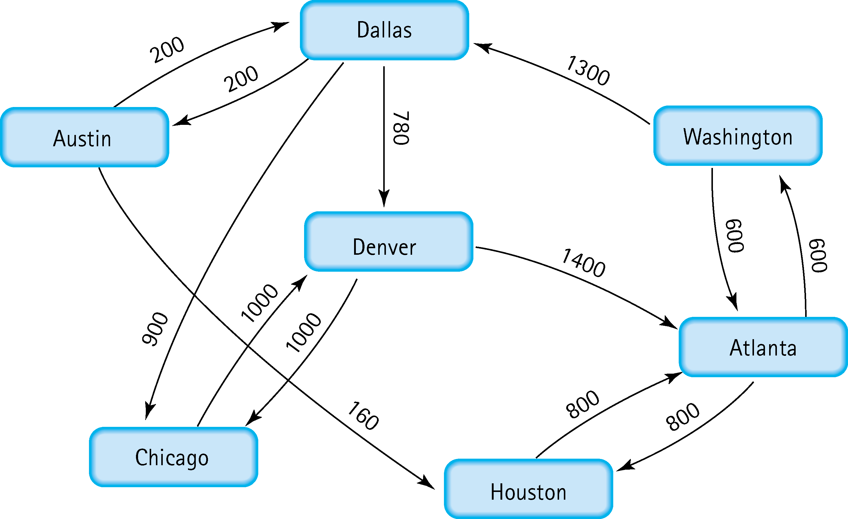
5. Find the shortest distance from Atlanta to every other city
FROM | TO | COST
Atlanta | Atlanta | -
Atlanta | Austin | 2100
Atlanta | Chicago | 2800
Atlanta | Dallas | 1900
Atlanta | Denver | 2680
Atlanta | Houston | 800
Atlanta | Washington | 600

Slide 5
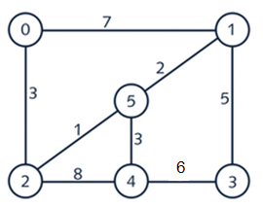
6. Find the minimal spanning tree using Prim’s algorithm. Use
0 as the source vertex . Show the steps.
Iteration | Vertex Added | Edge Added | Cost
0 | 0 | - | -
1 | 2 | 0-2 | 3
2 | 5 | 2-5 | 1
3 | 1 | 5-1 | 3
4 | 4 | 5-4 | 2
5 | 3 | 1-3 | 5
0
1
5
2
4
3

Slide 6
7. Find the minimal spanning tree using Kruskal’s algorithm.
Show the weights in order and the steps.
Edge | Cost
2-5 | 1
5-1 | 2
5-4 | 3
0-2 | 3
1-3 | 5
4-3 | 6
0-1 | 7
2-4 | 8
0
1
5
2
4
3

Slide 7
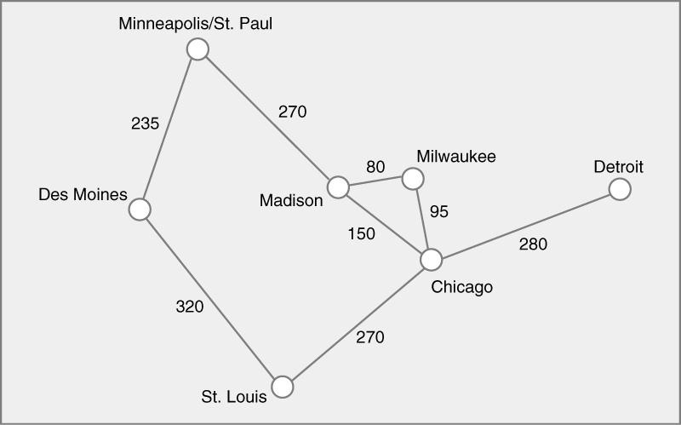
8. Find the minimal spanning tree using the algorithm you prefer. Use
Minneapolis/St. Paul as the source vertex
Edge | Cost
Madison-Milwaukee | 80
Milwaukee-Chicago | 95
Madison-Chicago | 150
Des Moines-Minneapolis | 235
Minneapolis-Madison | 270
St. Louis-Chicago | 270
Chicago-Detroit | 280
Des Moines-St. Louis | 320
Minneapolis/St. Paul
Milwaukee
Detroit
Des Moines
Madison
Chicago
St. Louis

Slide 8
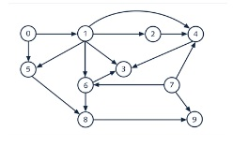
9. List the nodes of the graph in a breadth first topological ordering. Show the
steps using arrays predCount, topologicalOrder and a queue
In-Degree Array
Queue
0
1
2
3
4
5
6
7
8
9
0
1 0
1 0
3 2 1 0
3 2 1 0
2 1 0
2 1 0
0
2 1 0
2 1 0
0 1 5 2 7 4 6 3 8 9
0 1 5 2 7 4 6 3 8 9

Slide 9

10. List the nodes of the graph in a breadth first topological ordering.
Start, Discrete Math, Programming 1, Programming 2, Computer Organization, Algorithms, High-level Languages, Operation Systems, Theory of Computation, Compilers, Senior Seminar, End

